Slide 1

Out of Order Execution
THE KEY TO FASTER AND SMARTER CPUS

Slide 2
Introduction - What is an Out-of-Order Execution?
Dynamically reorders instructions
Executes ready instructions regardless of program order
Reduces idle time, improves CPU efficiency
Key to modern high-performance processors
Instructions may execute out of program order
Results are committed in order
Program correctness is preserved

Slide 3
Introduction - Why Out-of-Order Execution?
In-order CPUs face stalls due to:
Data hazards & memory latency
Idle CPU cycles (waiting for operands)
Inefficient resource utilization
OOO Execution:
Reorders instructions dynamically
Executes ready instructions first
Keeps CPU busy which boosts performance

Slide 4
Introduction - Limitations of In-Order Execution
Pipeline stalls from:
Data hazards
Memory latency
Branch instructions
Idle CPU cycles means wasted performance
Dependent instructions block independent ones

Slide 5
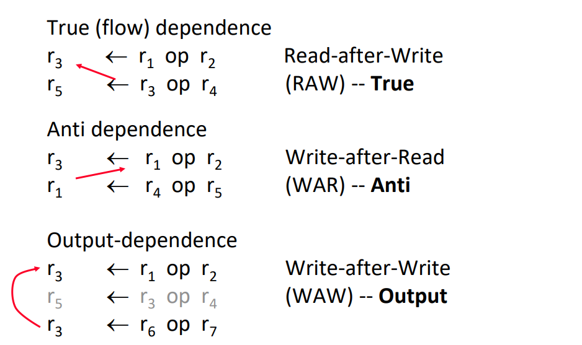
Data Hazards In Out-of-Order Execution

Slide 6
Data Hazards In Out-of-Order Execution
RAW (Read After Write) – A later instruction needs a value that an earlier one hasn’t produced yet. → Must wait (true dependency).
WAR (Write After Read) – A later instruction wants to overwrite a register before an earlier one has finished reading it. → Causes an unnecessary stall (false dependency).
WAW (Write After Write) – Two instructions want to write to the same register. → The later write must wait, even if they are unrelated (false dependency).
Problem: WAR and WAW only happen because instructions share the same register names, not because of real data needs.
Solution: Register Renaming → give each instruction its own physical register, removing these false conflicts.

Slide 7
Pipeline Overview
Pipeline stages in my Out-of-Order core:
Fetch → bring instruction from memory
Decode & Rename (RAT, ROB, PRF) → allocate physical registers & ROB entry
Dispatch to Reservation Stations (RS) → wait until operands are ready
Execute Units → ALU, MUL, Load/Store Units
Finished Buffers →
FSB (Finished Store Buffer)
FLB (Finished Load Buffer)
Completed Store Buffer (CSB) → final store commit to memory
Commit (via ROB → ARCHMAP update) → update architectural state

Slide 8
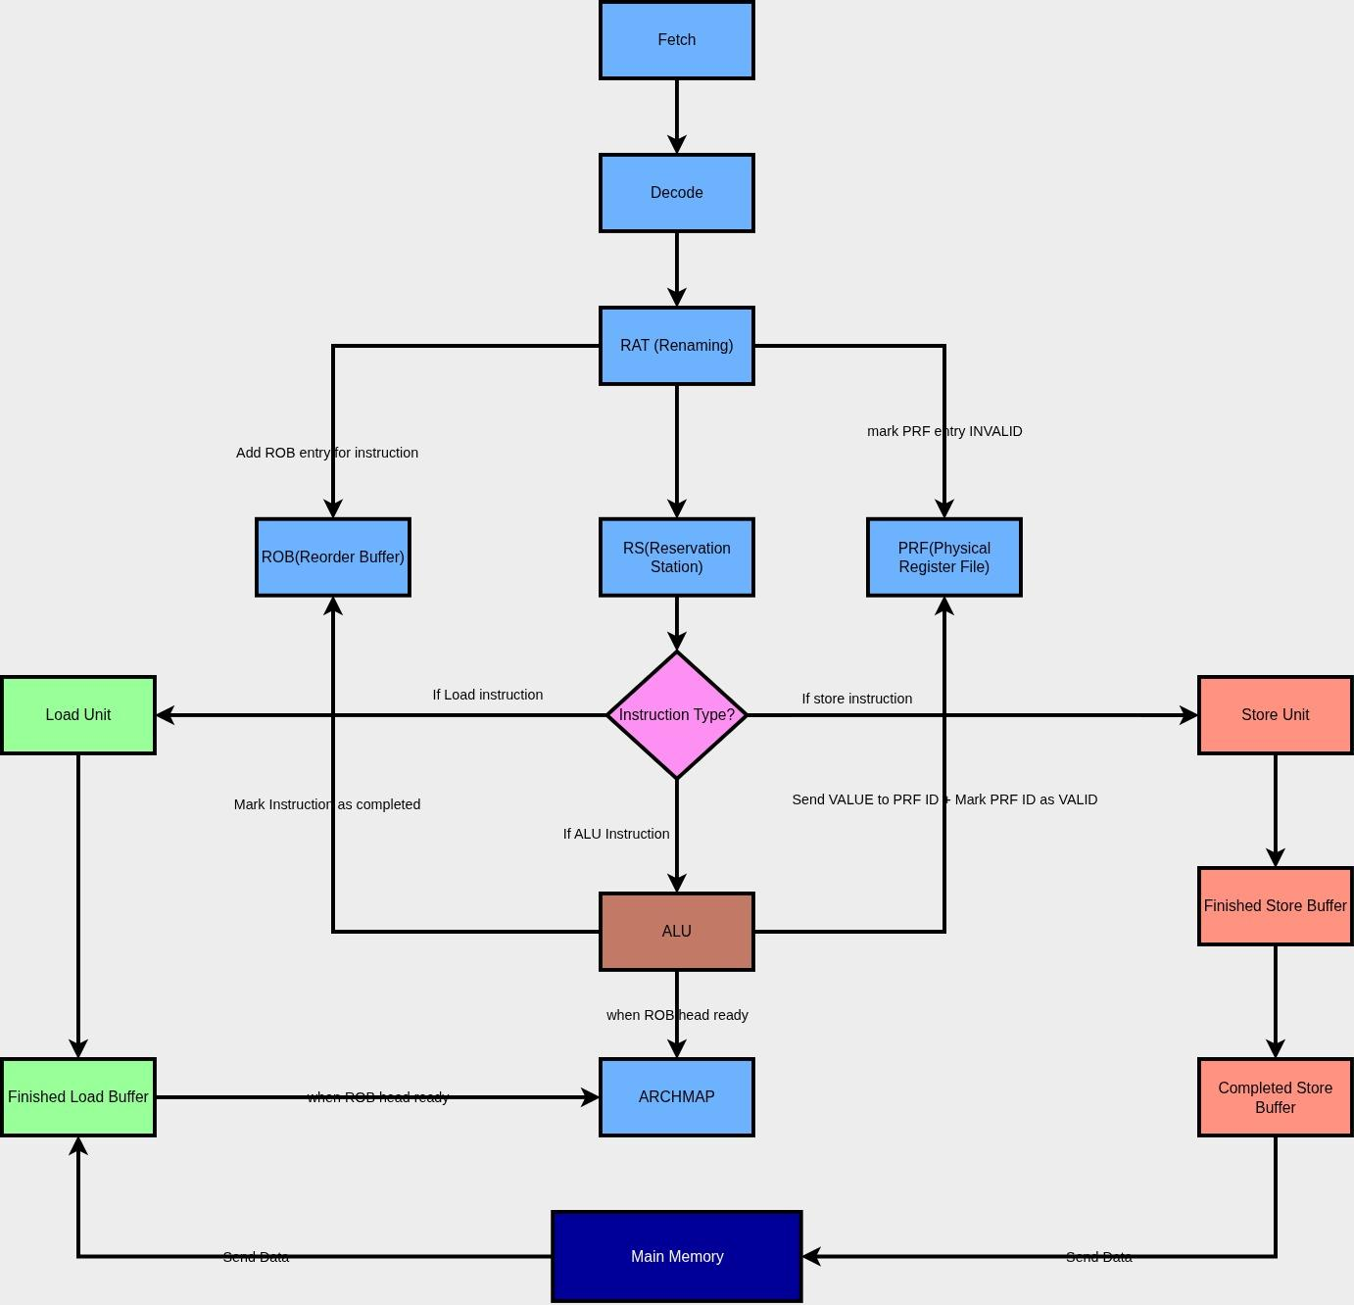
Pipeline Overview

Slide 9
Tomasulo’s Algorithm
Dynamically schedules instructions out-of-order while avoiding hazards
Resolves data hazards using:
Register renaming (RAT + PRF)
Reservation Stations (RS)
Uses Common Data Bus (CDB) to forward results as soon as they’re ready
Maintains precise commit with ROB
Handles RAW, WAW, and WAR hazards transparently

Slide 10
Register Alias Table (RAT)
Maps architectural registers to physical registers
Enables register renaming to remove false dependencies (WAR/WAW)
Updated during decode/rename stage
Ensures newly fetched instructions see the latest mapping for operands
Provides physical register IDs(P1,...PN) to instruction operands
Old mappings restored if branch misprediction/flush occurs
At commit, mapping is made permanent in ARCHMAP
REGISTER | PRF ID
x0 | PRF0 (Hardwired)
x1 | PRF1
x2 | PRF2
…. | ...
x31 | PRF31

Slide 11
Reorder Buffer (ROB)
RD(5 bits) | Current_RD PRF_ID | Previous_RD PRF_ID | Completed(1bit) | PC(32 bits) | ROB_INDEX
Holds instructions in program order
Tracks instruction status (executed, ready to commit)
Ensures in-order retirement of instructions
Handles precise exceptions by flushing younger instructions
Provides ROB index to link with RS/FSB/FLB
On commit:
For register writes → signals ARCHMAP update with new physical register
For stores → signals move from FSB → CSB → memory
Then frees ROB entry

Slide 12
Physical Register File (PRF)
Data | Valid
Holds actual data values (operands, results)
Larger than architectural register set
Each entry has valid/ready bits:
valid=0 → data not yet produced (RS must wait)
valid=1 → data ready for use
Provides operands directly to execution units or via CDB broadcast
PRF can hold multiple versions of a register; new ones are invalid until execution finishes and data is written back.
Old physical registers freed after commit

Slide 13
Reservation Station (RS)
RD PRF_ID | RD(5bit) | RS1 PRF_ID | RS1_Ready(1 bit) | RS2 PRF_ID | RS2_Ready(1 bit) | Immediate(32 bits) | OPCODE (7 bits) | Func3 | Func7
Buffers instructions waiting for execution
Stores opcode, immediate, source PRF IDs with ready bits, and destination PRF ID + ROB index.
Does not store operand values (they remain in PRF)
Waits until operands are marked ready (via PRF valid bits and CDB broadcast)
When ready → RS reads operand values from PRF using src PRF IDs, then sends opcode, immediate, operand values, dest PRF ID, and ROB index to the execution unit(so execution unit can later signal ROB completion via CDB)

Slide 14
Execute Stage (EX)
Perform computations once operands are ready
Units in the core:
ALU(s): arithmetic and logic operations
MUL/DIV units: multiplication and division
Load Unit: calculates addresses for load instructions
Store Unit: calculates addresses for store instructions
Having separate Load/Store Units allows memory addresses and arithmetic to be processed at the same time

Slide 15
Common Data Bus (CDB)
Broadcasts results from execution units
Carries value + destination PRF ID + ROB index
Stores the value into the correct PRF entry and sets its valid bit = 1
Since RS checks PRF valid bits, this makes waiting operands become ready automatically
Lets the ROB mark the instruction as completed (using its ROB index)
ALU / MUL / DIV: broadcast result value + dest PRF ID + ROB index
Load: memory returns data → then broadcast on CDB with dest PRF ID + ROB index
Store: does not use CDB (address/data go to store buffers instead)

Slide 16
Finished Load Buffer (FLB)
Address(32 bits) | Data(32 bits) | DataReady(1 bit) | RD PRF_ID | ROB_INDEX
Holds load instructions after address calculation, while waiting for memory data
Stores address, destination PRF ID, and ROB index
When memory responds, data is placed into the FLB entry
Then broadcast on CDB → updates PRF and ROB, wakes up RS
Acts as a waiting area to hide memory latency

Slide 17
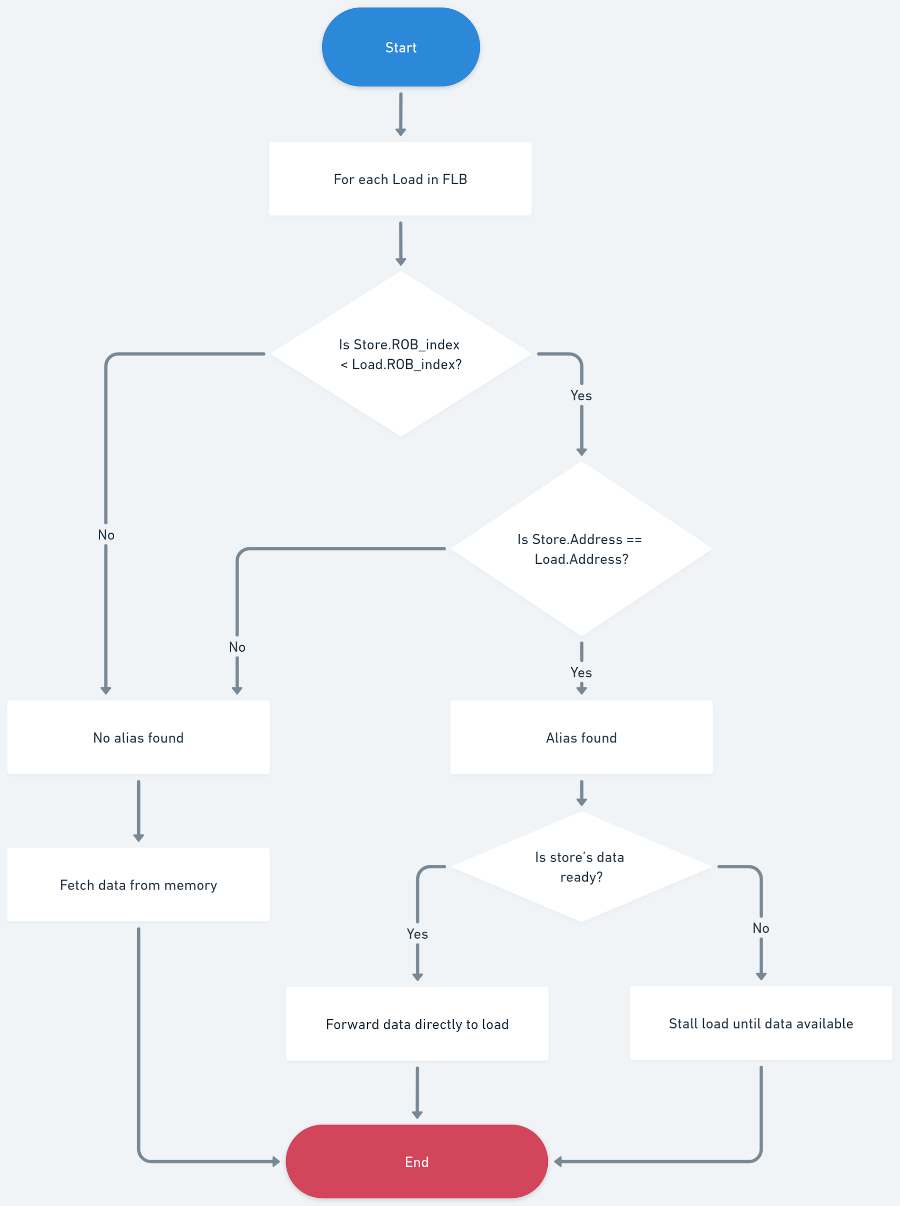
Finished Load Buffer (FLB) Algorithm

Slide 18
Finished Store Buffer (FSB)
Address(32 bits) | Data(32 bits) | DataReady(1 bit) | ROB_INDEX
Holds store instructions after address calculation
Stores address, store data (from PRF), and ROB index
Performs address alias checks against younger loads to detect hazards
Ensures stores don’t write memory until they are safe and at commit
If a conflict is found (e.g., younger load executed early with same address) → flush pipeline to maintain correctness

Slide 19
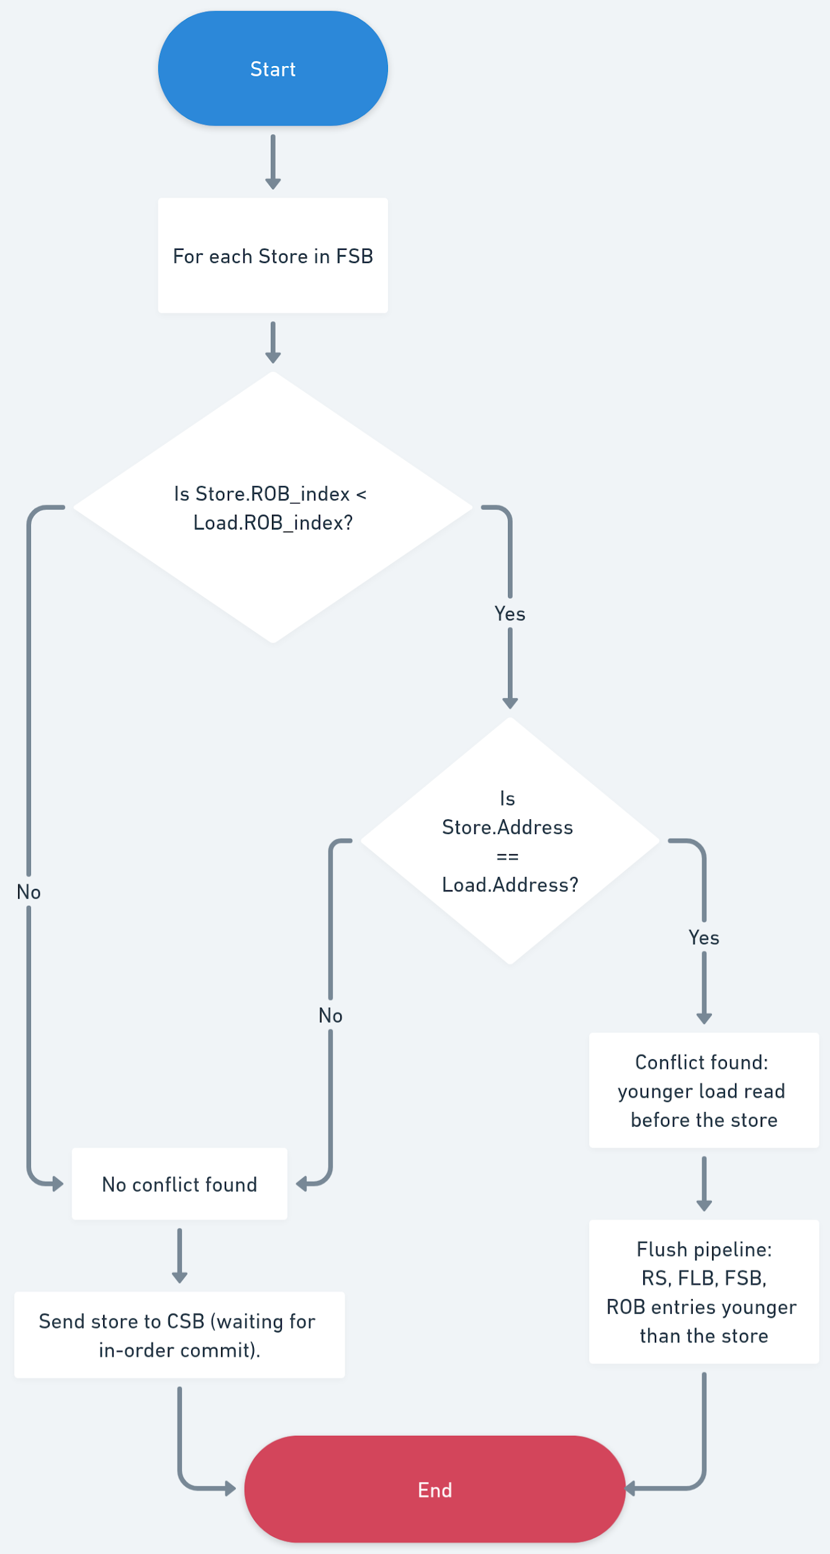
Finished Store Buffer (FSB) Algorithm

Slide 20
Flushing Algorithm
Identify the mis-speculated store’s ROB index.
Flush all instructions in pipeline with ROB_index ≥ bad_store_index:
Reservation Stations (clear affected entries)
FLB (remove younger loads)
FSB (remove younger stores)
ROB (clear younger entries)
Reset pipeline fetch to the correct PC after the last committed instruction.
Resume execution with correct ordering.

Slide 21
Completed Store Buffer (CSB)
Address(32 bits) | Data(32 bits) | ROB_INDEX
Holds stores that have passed all FSB checks (safe to commit)
Each CSB entry stores the address, data, and ROB index, all copied from the FSB entry.
Acts as a final holding buffer before memory write
Writes stores to memory in ROB index order (program order), not arrival order
Keeps the pipeline simple and clean by separating hazard checking from memory writes
Ensures only safe stores are written to memory

Slide 22
Architectural Register Map (ARCHMAP)
Tracks the latest committed PRF for each architectural register
Updated by ROB at commit
Old PRFs can be freed after commit
Used to restore RAT after a flush or misprediction
Ensures correct architectural state
REGISTER | PRF ID
x0 | PRF0 (Hardwired)
x1 | PRF1
x2 | PRF2
…. | ...
x31 | PRF31

